Slide 1
Nondeterministic Finite Automata
Nondeterminism
Subset Construction

Slide 2
Nondeterminism
A nondeterministic finite automaton has the ability to be in several states at once.
Transitions from a state on an input symbol can be to any set of states.

Slide 3
Nondeterminism – (2)
Start in one start state.
Accept if any sequence of choices leads to a final state.
Intuitively: the NFA always “guesses right.”

Slide 4
Example: Moves on a Chessboard
States = squares.
Inputs = r (move to an adjacent red square) and b (move to an adjacent black square).
Start state, final state are in opposite corners.

Slide 5
Example: Chessboard – (2)
1
2
3
r b
2,4 5
4,6 1,3,5
2,6 5
2,8 1,5,7
2,4,6,8 1,3,7,9
2,8 3,5,9
4,8 5
4,6 5,7,9
6,8 5
4
5
6
7
8
9
r
b
b
1
2
1
5
4
3
1
*
5
3
7
7
9
Accept, since final state reached

Slide 6
Formal NFA
A finite set of states, typically Q.
An input alphabet, typically Σ.
A transition function, typically δ.
A start state in Q, typically q₀.
A set of final states F ⊆ Q.

Slide 7

Transition Function of an NFA
δ(q, a) is a set of states.
Extend to strings as follows:
Basis: δ(q, ε) = {q}
Induction: δ(q, wa) = the union over all states p in δ(q, w) of δ(p, a) formally:

Slide 8
Language of an NFA
A string w is accepted by an NFA if δ(q₀, w) contains at least one final state.
The language of the NFA is the set of strings it accepts.

Slide 9
Example: Language of an NFA
1
2
3
4
5
6
7
8
9
For our chessboard NFA we saw that rbb is accepted.
If the input consists of only b’s, the set of accessible states alternates between {5} and {1,3,7,9}, so only even-length, nonempty strings of b’s are accepted.
What about strings with at least one r?

Slide 10
Equivalence of DFA’s, NFA’s
A DFA can be turned into an NFA that accepts the same language.
If δ_{D}(q, a) = p, let the NFA have δ_{N}(q, a) = {p}.
Then the NFA is always in a set containing exactly one state – the state the DFA is in after reading the same input.

Slide 11
Equivalence – (2)
Surprisingly, for any NFA there is a DFA that accepts the same language.
Proof is the subset construction.
The number of states of the DFA can be exponential in the number of states of the NFA.
Thus, NFA’s accept exactly the regular languages.

Slide 12
Subset Construction
Given an NFA with states Q, inputs Σ, transition function δ_{N}, start state q₀, and final states F, construct equivalent DFA with:
States 2^{Q} (Set of subsets of Q).
Inputs Σ.
Start state {q₀}.
Final states = all those with a member of F.

Slide 13
Critical Point
The DFA states have names that are sets of NFA states.
But as a DFA state, an expression like {p,q} must be read as a single symbol, not as a set.

Slide 14

Subset Construction – (2)
The transition function δ_{D} is defined by:
δ_{D}({q₁,…,q_{k}}, a) is the union over all i = 1,…,k of δ_{N}(q_{i}, a). Formally
Example: We’ll construct the DFA equivalent of our “chessboard” NFA.

Slide 15
Example: Subset Construction
1
2
3
4
5
6
7
8
9
r b
2,4 5
4,6 1,3,5
2,6 5
2,8 1,5,7
2,4,6,8 1,3,7,9
2,8 3,5,9
4,8 5
4,6 5,7,9
6,8 5
r b
{1}
{2,4} {5}
{2,4}
{5}
*
Alert: What we’re doing here is the lazy form of DFA construction, where we only construct a state if we are forced to.

Slide 16
Example: Subset Construction
1
2
3
4
5
6
7
8
9
r b
2,4 5
4,6 1,3,5
2,6 5
2,8 1,5,7
2,4,6,8 1,3,7,9
2,8 3,5,9
4,8 5
4,6 5,7,9
6,8 5
r b
{1}
{2,4} {5}
{2,4}
{2,4,6,8} {1,3,5,7}
{5}
{2,4,6,8}
{1,3,5,7}
*

Slide 17
Example: Subset Construction
1
2
3
4
5
6
7
8
9
r b
2,4 5
4,6 1,3,5
2,6 5
2,8 1,5,7
2,4,6,8 1,3,7,9
2,8 3,5,9
4,8 5
4,6 5,7,9
6,8 5
r b
{1}
{2,4} {5}
{2,4}
{2,4,6,8} {1,3,5,7}
{5}
{2,4,6,8} {1,3,7,9}
{2,4,6,8}
{1,3,5,7}
* {1,3,7,9}
*

Slide 18
Example: Subset Construction
1
2
3
4
5
6
7
8
9
r b
2,4 5
4,6 1,3,5
2,6 5
2,8 1,5,7
2,4,6,8 1,3,7,9
2,8 3,5,9
4,8 5
4,6 5,7,9
6,8 5
r b
{1}
{2,4} {5}
{2,4}
{2,4,6,8} {1,3,5,7}
{5}
{2,4,6,8} {1,3,7,9}
{2,4,6,8}
{2,4,6,8} {1,3,5,7,9}
{1,3,5,7}
* {1,3,7,9}
* {1,3,5,7,9}
*

Slide 19
Example: Subset Construction
1
2
3
4
5
6
7
8
9
r b
2,4 5
4,6 1,3,5
2,6 5
2,8 1,5,7
2,4,6,8 1,3,7,9
2,8 3,5,9
4,8 5
4,6 5,7,9
6,8 5
r b
{1}
{2,4} {5}
{2,4}
{2,4,6,8} {1,3,5,7}
{5}
{2,4,6,8} {1,3,7,9}
{2,4,6,8}
{2,4,6,8} {1,3,5,7,9}
{1,3,5,7}
{2,4,6,8} {1,3,5,7,9}
* {1,3,7,9}
* {1,3,5,7,9}
*

Slide 20
Example: Subset Construction
1
2
3
4
5
6
7
8
9
r b
2,4 5
4,6 1,3,5
2,6 5
2,8 1,5,7
2,4,6,8 1,3,7,9
2,8 3,5,9
4,8 5
4,6 5,7,9
6,8 5
r b
{1}
{2,4} {5}
{2,4}
{2,4,6,8} {1,3,5,7}
{5}
{2,4,6,8} {1,3,7,9}
{2,4,6,8}
{2,4,6,8} {1,3,5,7,9}
{1,3,5,7}
{2,4,6,8} {1,3,5,7,9}
* {1,3,7,9}
{2,4,6,8} {5}
* {1,3,5,7,9}
*

Slide 21
Example: Subset Construction
1
2
3
4
5
6
7
8
9
r b
2,4 5
4,6 1,3,5
2,6 5
2,8 1,5,7
2,4,6,8 1,3,7,9
2,8 3,5,9
4,8 5
4,6 5,7,9
6,8 5
r b
{1}
{2,4} {5}
{2,4}
{2,4,6,8} {1,3,5,7}
{5}
{2,4,6,8} {1,3,7,9}
{2,4,6,8}
{2,4,6,8} {1,3,5,7,9}
{1,3,5,7}
{2,4,6,8} {1,3,5,7,9}
* {1,3,7,9}
{2,4,6,8} {5}
* {1,3,5,7,9}
{2,4,6,8} {1,3,5,7,9}
*

Slide 22
Proof of Equivalence: Subset Construction
Show by induction on |w| that
δ_{N}(q₀, w) = δ_{D}({q₀}, w)
Proof: on page 64 of the Book
Notes:
Pun= szójáték

Slide 23
NFA’s With ε-Transitions
We can allow state-to-state transitions on ε input.
These transitions are done spontaneously, without looking at the input string.
A convenience at times, but still only regular languages are accepted.

Slide 24
Example: ε-NFA
0 1 ε
A {E} {B} ∅
B ∅ {C} {D}
C ∅ {D} ∅
D ∅ ∅ ∅
E {F} ∅ {B, C}
F {D} ∅ ∅
ε
1
1
1
B
C
D
A
ε
*
ε
0
0
E
F
0

Slide 25
Closure of States
CL(q) = set of states you can reach from state q following only arcs labeled ε.
Example: CL(A) = {A};
CL(E) = {B, C, D, E}.
Closure of a set of states = union of the closure of each state.
ε
1
1
1
B
C
D
A
ε
ε
0
0
E
F
0

Slide 26
Extended Delta (delta-hat in the book, δ here)
Basis: (q, ε) = CL(q).
Induction: (q, xa) is computed as follows:
Start with the set S=δ(q, x).
Take the union of CL(δ(p, a)) for all p in S.
Intuition: (q, w) is the set of states you can reach from q following a path labeled w.
δ
δ
δ
And notice that δ(q, a) is not
that set of states, for symbol a.

Slide 27
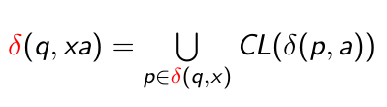
Example: Extended Delta
ε
1
1
1
B
C
D
A
ε
ε
0
0
E
F
0
δ(A, ε) = CL(A) = {A}.
δ(A, 0) = CL({E}) = {B, C, D, E}.
δ(A, 01) = CL({C, D}) = {C, D}.
Language of an ε-NFA is the set of strings w such that δ(q₀, w) contains a final state.

Slide 28
Equivalence of NFA, ε-NFA
Every NFA is an ε-NFA.
It just has no transitions on ε.
Converse requires us to take an ε-NFA and construct an NFA that accepts the same language.
We do so by combining ε–transitions with the next transition on a real input.
Warning: This treatment is a
bit different from that in the text.

Slide 29
Picture of ε-Transition Removal
a
a
a
Transitions
on ε
Transitions
on ε

Slide 30
Picture of ε-Transition Removal
To here, and performs
the subset construction
Text goes
from here
a
a
a
Transitions
on ε
Transitions
on ε

Slide 31
Picture of ε-Transition Removal
To here, with no
subset construction
a
We’ll go
from here
a
a
Transitions
on ε
Transitions
on ε

Slide 32
Equivalence – (2)
Start with an ε-NFA with states Q, inputs Σ, start state q₀, final states F, and transition function δ_{E}.
Construct an “ordinary” NFA with states Q, inputs Σ, start state q₀, final states F’, and transition function δ_{N}.

Slide 33
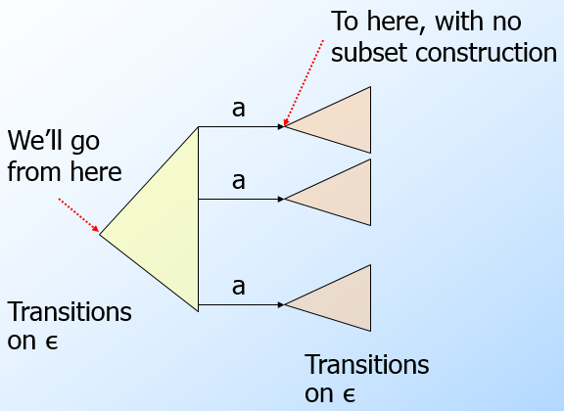
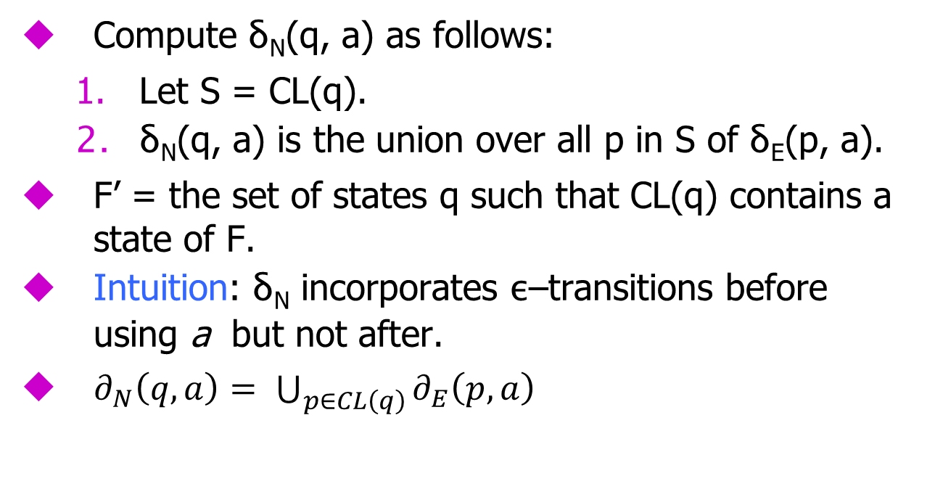

Compute δ_{N}(q, a) as follows:
Let S = CL(q).
δ_{N}(q, a) is the union over all p in S of δ_{E}(p, a).
F’ = the set of states q such that CL(q) contains a state of F.
Intuition: δ_{N} incorporates ε–transitions before using a but not after.
$∂_{N}\left(q,a\right)= \bigcup_{p∈CL\left(q\right)}{∂_{E}\left(p,a\right)}$
$$F^{′}=\left\{q | CL(q)∩F≠∅\right\}$$

Slide 34
Equivalence – (4)
Prove by induction on |w| that
CL(δ_{N}(q₀, w)) = _{E}(q₀, w).
Thus, the ε-NFA accepts w if and only if the “ordinary” NFA does.
δ

Slide 35
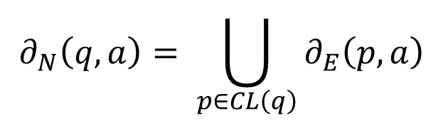

Example: ε-NFA-to-NFA
ε
1
1
CL(A)={A}, CL(C)={C},CL(F)={F},CL(D)={D}
CL(B)= {B,D}; CL(E)= {B,C,D,E}
1
B
C
D
A
ε
ε
$$∂_{N}\left(q,a\right)= \bigcup_{p∈CL\left(q\right)}{∂_{E}\left(p,a\right)}$$
0
0
E
F
0
ε-NFA
0 1 ε
A {E} {B} ∅
B ∅ {C} {D}
C ∅ {D} ∅
D ∅ ∅ ∅
E {F} ∅ {B, C}
F {D} ∅ ∅
NFA
0 1
A {E} {B}
B ∅ {C}
C ∅ {D}
D ∅ ∅
E {F} {C, D}
F {D} ∅
*
*
*
*
Since closure of
E includes B and
C; which have
transitions on 1
to C and D.
$$F^{′}=\left\{q | CL(q)∩F≠∅\right\}$$
Since closures of
B and D and E include
final state D.

Slide 36
Summary
DFA’s, NFA’s, and ε–NFA’s all accept exactly the same set of languages: the regular languages.
The NFA types are easier to design and may have exponentially fewer states than a DFA.
But only a DFA can be implemented!

